Slide 1
Network Noobs
Unit 6.1
Cybersecurity Boot Camp |
August 28, 2018

Slide 2
Today’s Class

Slide 3
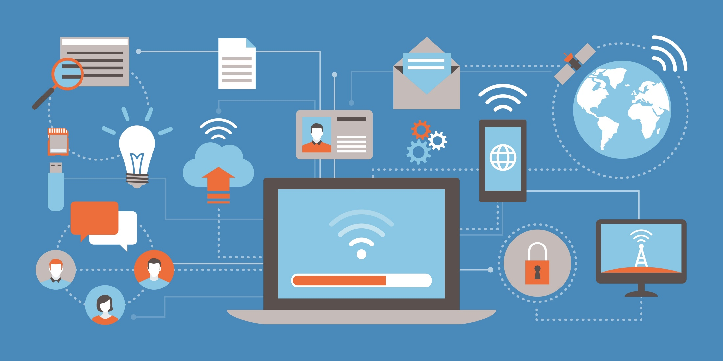
Networks! Networks! Networks!
This week we’ll be digging into the concept of Networks – highlighting the devices and configuration central to modern computing.
Notes:
Review goals; address any questions.

Slide 4
Today’s Goals
By the end of class, you will be able to:
Define a Computer Network in layman terms.
Articulate the rationale behind the development of Computer Networks.
Distinguish the most common network devices based on their use case.
Explain the concept of Routing and Packet Forwarding in your own words.
Design a few simple Network schematics using simple network diagramming tools.
Notes:
Review goals; address any questions.

Slide 5
Basic Definitions

Slide 6
Let’s start with a basic question:
What exactly is a “computer network”?

Slide 7

Computer Networks: A Formal Definition
A Computer Network is a digital telecommunications network which allows nodes to share resources. In computer networks, devices exchange data with each other using connections (data links) between nodes. These data links can be over cable media (wires or optic cables) or wireless media (WiFi).
Notes:
Review goals; address any questions.

Slide 8

Computer Networks: A Simple Definition
A Computer Network is a connection between two or more computers with the intention of sharing information between them.
Notes:
Review goals; address any questions.

Slide 9
Connecting Computers
Connections between computers are typified in two ways:
Physical Connections: The physical medium (Wires, Wireless Media Devices, Etc.)
Logical Connections: The abstract path data takes in order to arrive from Point A to Point B.
Notes:
Review goals; address any questions.

Slide 10
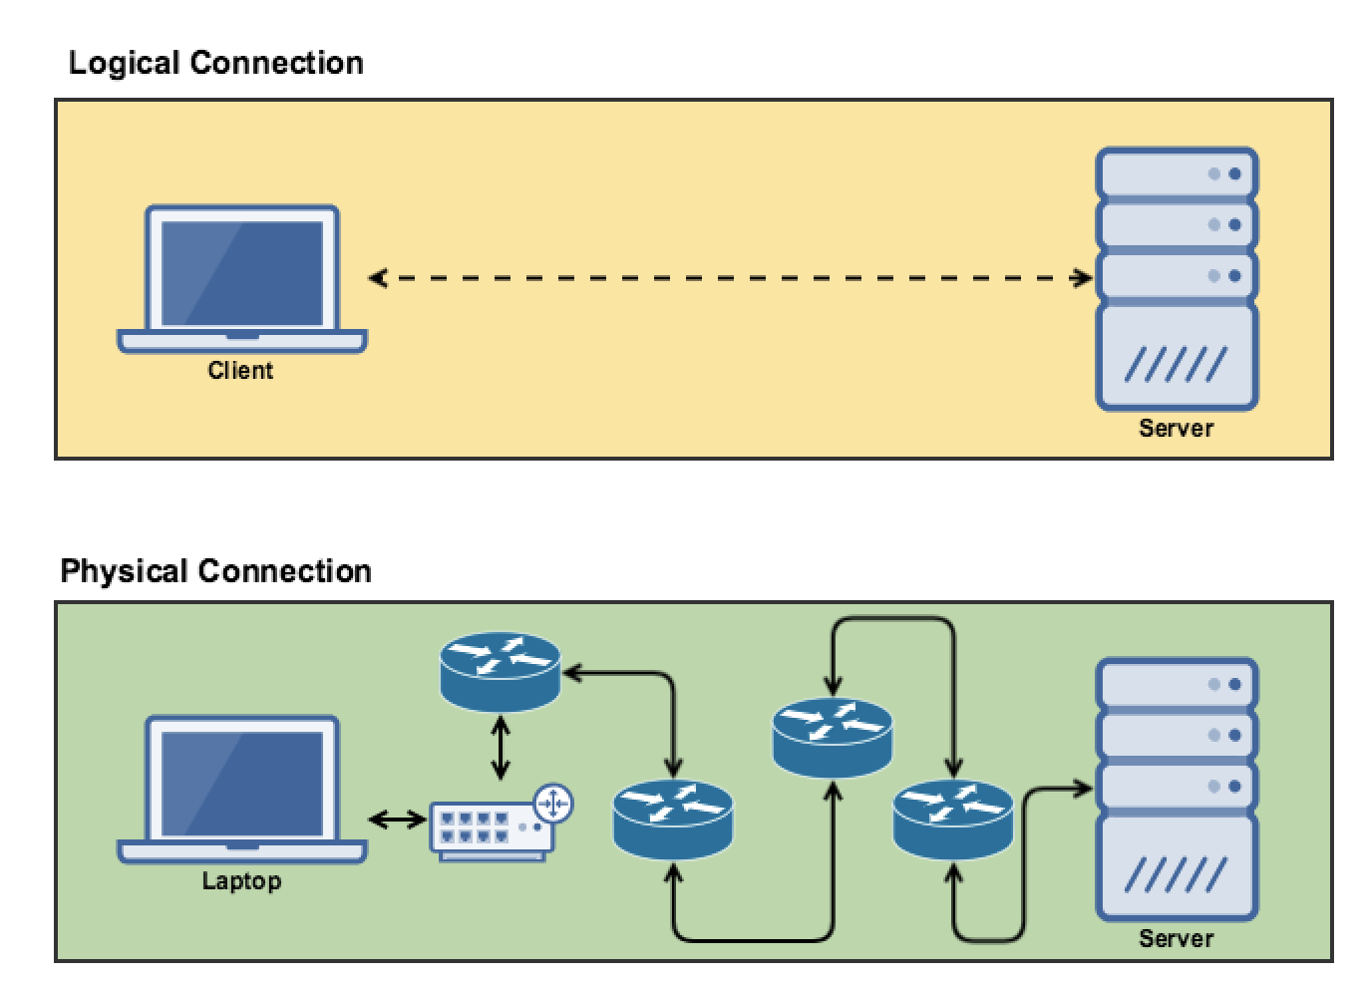
Connecting Computers
Includes all of the wires and routing devices.
Connections between computers are typified in two ways:
Physical Connections: The physical medium (Wires, Wireless Media Devices, Etc.)
Logical Connections: The abstract path data takes in order to arrive from Point A to Point B.
Notes:
Review goals; address any questions.

Slide 11
Connecting Computers
Abstracts away all devices to reference only end-points.
Connections between computers are typified in two ways:
Physical Connections: The physical medium (Wires, Wireless Media Devices, Etc.)
Logical Connections: The abstract path data takes in order to arrive from Point A to Point B.
Notes:
Review goals; address any questions.

Slide 12
A Classic Network of Today…
Most of us are familiar with simple
Small Office Home Office (SOHO) Networks…
Notes:
Review goals; address any questions.

Slide 13
Modern Enterprise Network
But as is often the case in the security field, being able to navigate more sophisticated enterprise networks is a critical part of the job.
Notes:
Review goals; address any questions.

Slide 14
Throughout the week, we’ll arm you with the knowledge you need to make sense of complex-seeming networks like this one.

Slide 15
The Power of Networks

Slide 16
Let’s try another basic question:
Why do computer networks exist?
(Hint: Think Beyond “The Internet”)

Slide 17
Why Build Networks?
Reason #1: Centralization of Resources and Critical Data
Notes:
Review goals; address any questions.

Slide 18

Why Build Networks?
Reason #2: Fast, Efficient Communication
Notes:
Review goals; address any questions.

Slide 19
Why Build Networks?
Reason #3: Data Sharing
Notes:
Review goals; address any questions.

Slide 20
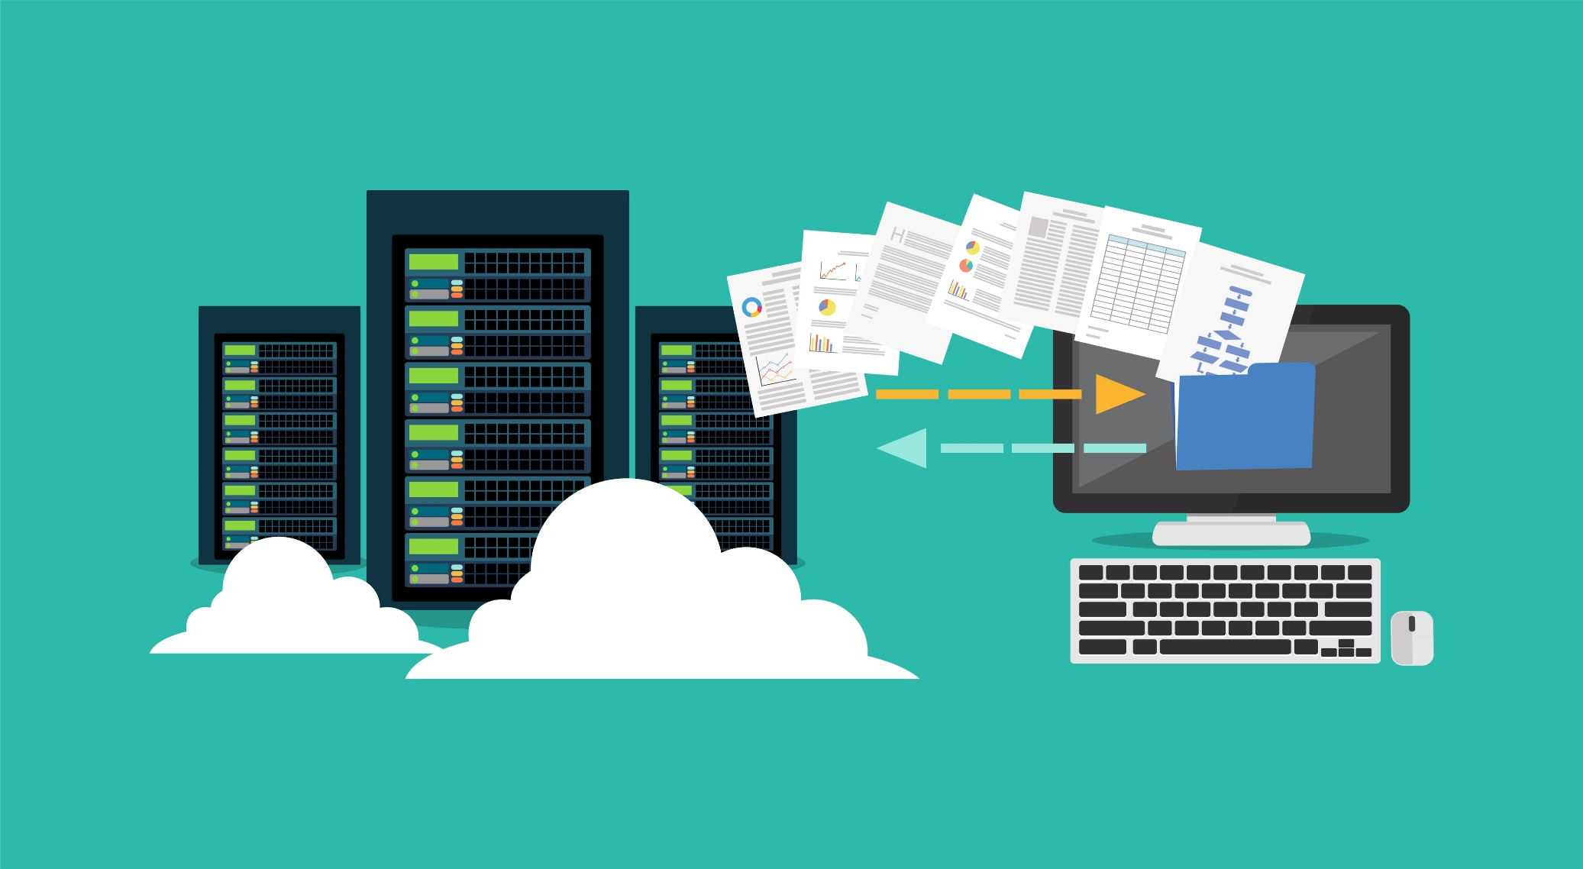
Why Build Networks?
Reason #4: Backup and Recovery
Notes:
Review goals; address any questions.

Slide 21
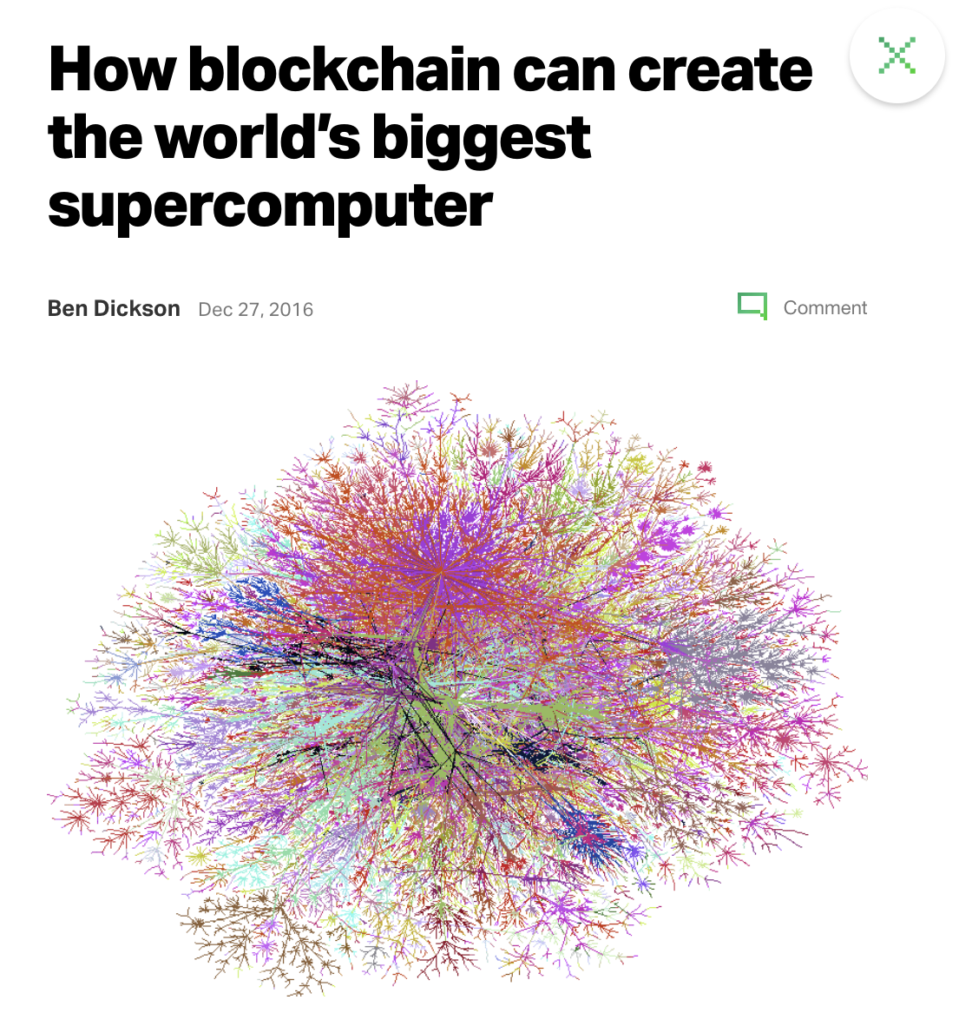
Why Build Networks?
Reason #5: Distribution of Computing Power
Notes:
Review goals; address any questions.

Slide 22
Network Devices 101

Slide 23
In today’s class, we’ll be designing simple networks using the core network devices used today.

Slide 24
Networking… It’s About More Than Modems
Most of us have something like this at home: All-In-One Network Devices that package multiple sub-devices into one.
These devices bundle the capabilities of a Router, Wireless Access Point, Modem, and Switch into one device.
In this class, it will be important to understand Network devices with greater nuance.
Notes:
Review goals; address any questions.

Slide 25
Network Devices
Router
Switch (and Hubs)
Bridge
Firewall
Network Interface Cards (NICs)
Wireless Access Point
Modem
Wifi Router
Servers (HTTP, DHCP, FTP)
Pro Tip
By the end of the week you should be comfortable defining each of these with relative ease.
Notes:
Review goals; address any questions.

Slide 26
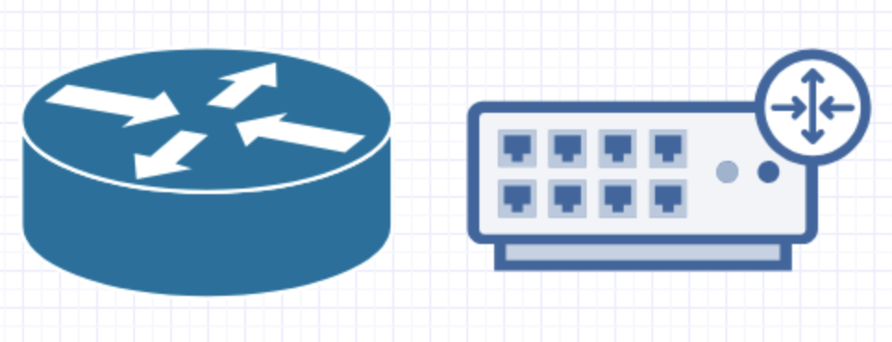
Network Devices: Routers
Definition:
Networking device that forwards data packets between computer networks. Routers play the role of directing traffic through the internet.
Commentary:
The simplest routers forward IP packets between home computers and the web. In enterprises, routers can play the role of chaining computer systems in internal networks.
We’ll spend more time talking about routing later today!
Physical Device
Diagram Representations
Notes:
Review goals; address any questions.

Slide 27
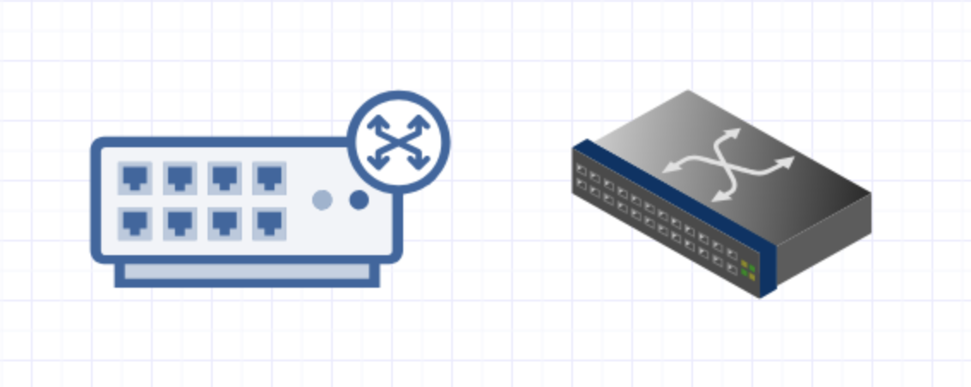
Network Devices: Switch
Definition:
Network switches are computer networking devices that connect multiple devices together. Switches can distinguish between each device and serves as a central controller.
Commentary:
Switches seem similar to routers but are very different. Switches create networks, while Routers connect them. Typically you will see switches feed into Routers.
Physical Device
Diagram Representations
Notes:
Review goals; address any questions.

Slide 28
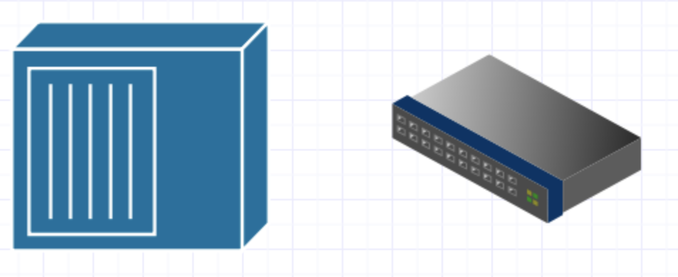
Network Devices: Hubs (Dated)
Definition:
Network Hubs are an older version of switches. Like switches they serve as a common connection point for devices, but unlike Switches – they cannot differentiate between each device. Instead they rely on constantly broadcasting communication to all devices.
Commentary:
Hubs are inherently less secure than Switches because data from each device is communicated to all other devices.
Physical Device
Diagram Representations
Notes:
Review goals; address any questions.

Slide 29

Network Devices: Bridge
Physical Device
Definition:
Bridges are effectively switches but with only two ports available. They are often used to tie two LANs together.
Commentary:
Bridges are often used to tie two LANs together.
Diagram Representations
Notes:
Review goals; address any questions.

Slide 30

Network Devices: Firewall
Definition:
Firewalls are network security systems that monitor incoming and outgoing traffic based on security rules.
Commentary:
Firewalls are often categorized as network firewalls and host-based firewalls. Host-based firewalls are like the software that runs on your machine. Network-based firewalls are devices that monitor traffic in and out of network hardware.
Physical Device
Diagram Representations
Notes:
Review goals; address any questions.

Slide 31
Network Devices: Network Interface Controller (NIC)
Definition:
Network Interface Controllers (NICs) describe computer hardware that connects a computer to a computer network. These devices allow computers to connect via the standard physical and data layers associated with Ethernet and Wi-Fi.
Commentary:
Every NIC is assigned a MAC address, printed on the device. This gives it a truly unique address.
We’ll talk more about MAC and IP addresses later today.
Physical Device
Notes:
Review goals; address any questions.

Slide 32

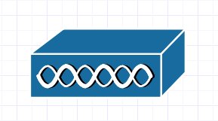
Network Devices: Wifi Router
Physical Device
Definition:
A Wireless Access Point (WAP) is a network hardware device that allows a Wi-Fi device to connect to a wired network. The WAP connects to a router as a standalone device the way a typical wired device might.
Commentary:
Increasingly WAPs are built into routers as in the case of all-in-one devices.
Diagram Representations
Notes:
Review goals; address any questions.

Slide 33
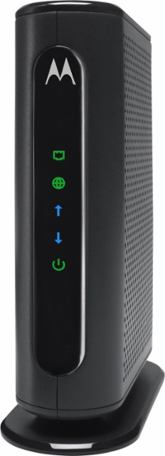
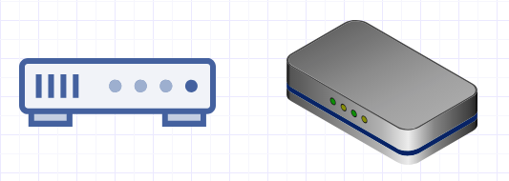
Network Devices: Modem
Definition:
Modems (modulator – demodulator) are network devices that convert digital information for transmission and converts transmitted information into digital information. Modems can be used to convert data into light waves, electric signals, or radio signals.
Commentary:
In essence, the hallmark role the modem plays is to convert data into a format that can be relayed across long distances over wires, electromagnetic waves, or light.
Physical Device
Diagram Representations
Notes:
Review goals; address any questions.

Slide 34
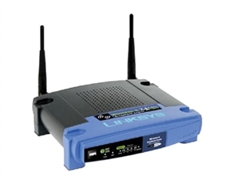
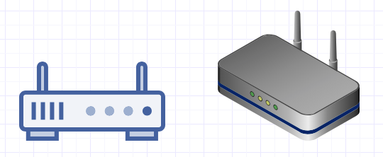
Network Devices: Wireless Router
Physical Device
Definition:
Wireless routers are devices that combine the functionality of routers and wireless access point. Often these devices include the all-in-one capabilities of also incorporating Ethernet Switches and Modems.
Commentary:
Increasingly WAPs are built into routers as in the case of all-in-one devices.
Diagram Representations
Notes:
Review goals; address any questions.

Slide 35
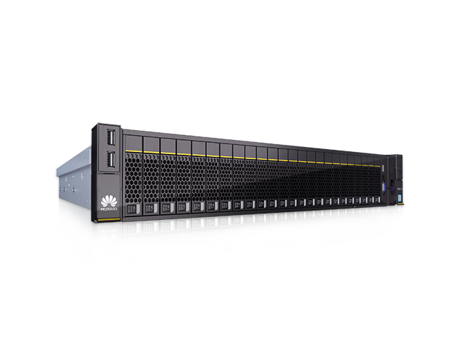
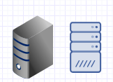
Network Devices: Servers
Definition:
Servers are computer devices that provide functionality for other programs or devices.
Commentary:
Servers aren’t truly network devices per-se. They are more akin to the personal computers that we tie into a network. Servers often house the data and business logic of a company. Networks provide a pathway for accessing this data.
We’ll spend more time talking about servers later in this course.
Physical Device
Diagram Representations
Notes:
Review goals; address any questions.

Slide 36
Activity: What’s That Device? (10 Minutes)
Take a few moments to turn to the person next to you and answer each of the following questions:
Which device would I use to direct traffic across multiple local or wide area networks?
Which device would I use to control traffic among multiple wired devices on a single network?
What is the difference between a hub and a switch? What might be the security implications of this?
What is a network interface card for? What does it have to do with a MAC address?
What exactly is a modem? How is this different from a router?
What might be the advantages of using a single all-in-one device?
What might be the advantage of using separate devices for each function?

Slide 37
Let’s start using these devices!

Slide 38
Network Design Diagrams

Slide 39
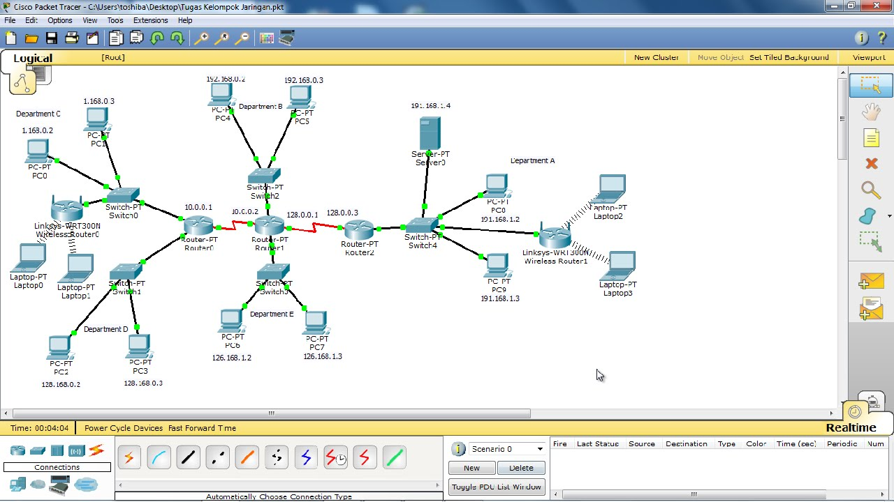
Packet Tracer
Next class we’ll be beginning our work with Cisco Packet Tracer – an advanced simulation tool for working with Networks...
Notes:
Review goals; address any questions.

Slide 40
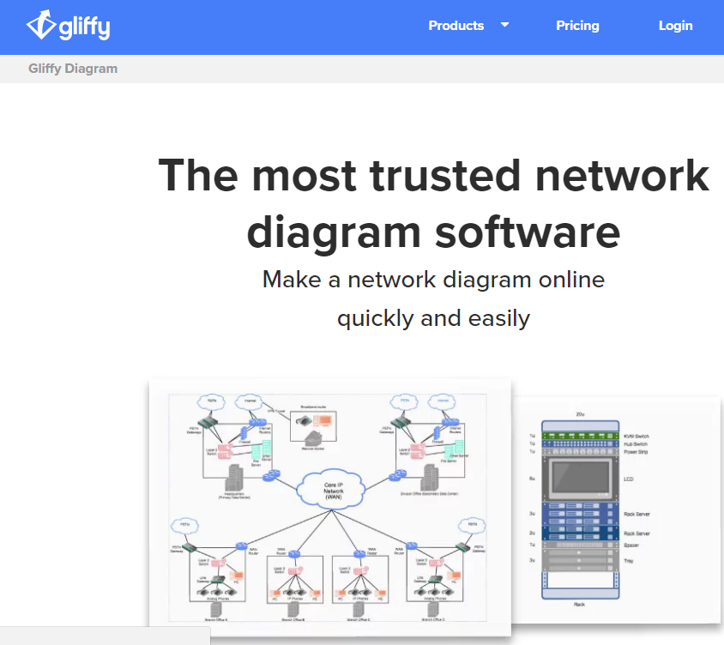
Packet Tracer
…But this class to ease into the concept we’ll be working with Gliffy, an online diagramming software that provides an easy to use interface for creating network diagrams.
Notes:
Review goals; address any questions.

Slide 41
Activity: Gliffy Registration + Exploration (10 Minutes)
Take a few moments to complete each of the below tasks:
Create a free account on the Gliffy website (http://gliffy.com).
Login to your account and then figure out how to enable “Network Shapes”.
Then, place each of the Network elements listed below somewhere on your page.
Router
Switch
Hub
Server
Web Server
Database
Next, apply a label to each of these elements with their name below.
Finally, create a very simple diagram in which two workstations are connected to a switch that is connected to a router which is connected to the internet.
Workstation
Laptop
Cloud (Internet)
Firewall
Database
Modem
Wireless Modem
Load Balancer

Slide 42
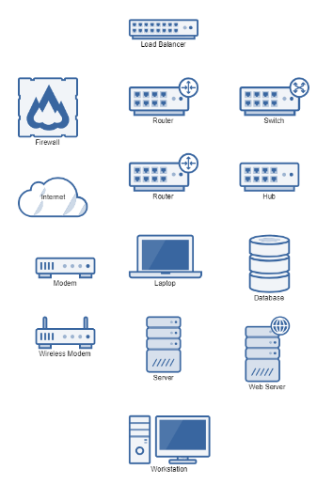
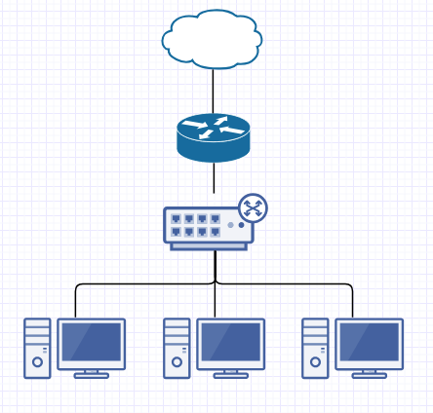
Gliffy Exploration
Network Elements
Simple Network Diagram
Notes:
Review goals; address any questions.

Slide 43
Network Design 101

Slide 44
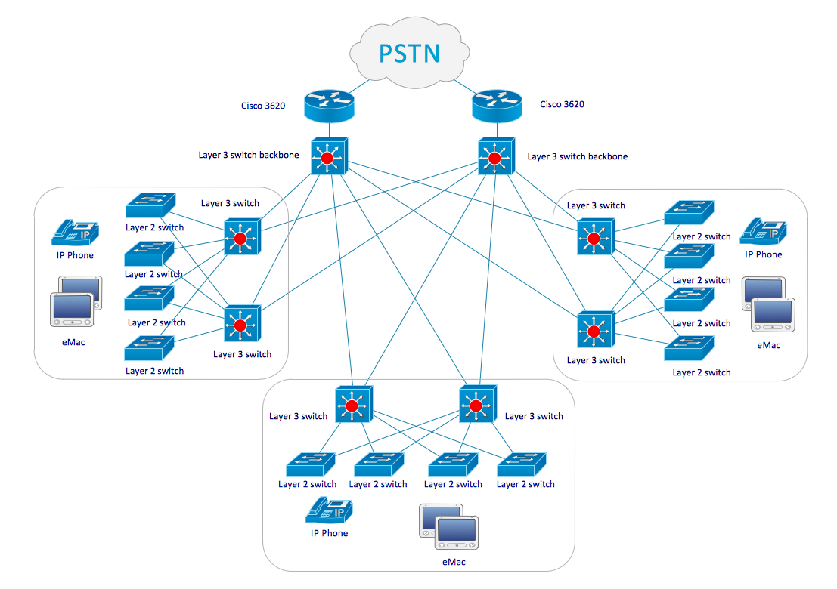
Network Diagramming Basics
It’s easy to get intimidated by all the diagrammatic elements.
But here are a few guiding principles to get started.
Notes:
Review goals; address any questions.

Slide 45
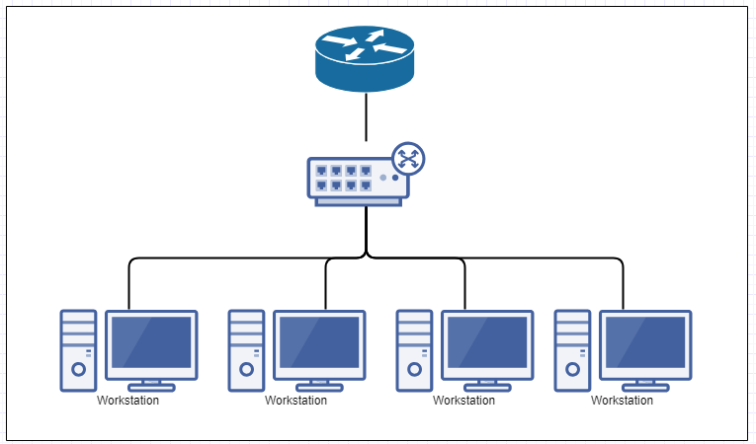
Network Diagramming Basics
Switch
Switches are used to connect multiple computers into a single network. These will then feed into Routers.
Notes:
Review goals; address any questions.

Slide 46
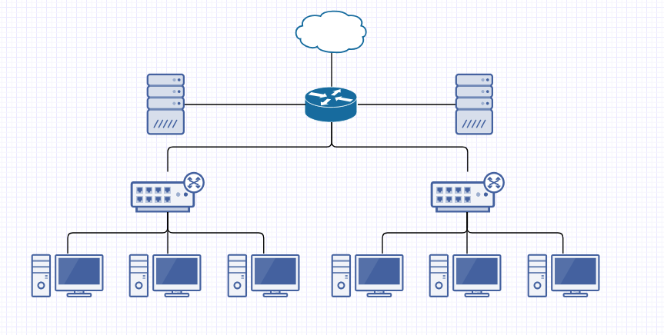
Network Diagramming Basics
Router
Routers can connect directly to Servers, Switches, Firewalls, or the Internet. (Ignore modems for diagrams)
Notes:
Review goals; address any questions.

Slide 47
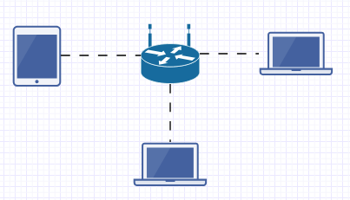
Network Diagramming Basics
Wi-Fi Router
Wireless Routers should be used to connect multiple wireless devices (smartphones, laptops, etc.)
Notes:
Review goals; address any questions.

Slide 48
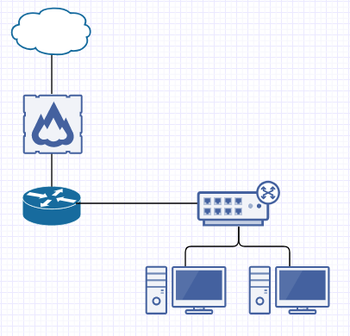
Network Diagramming Basics
Firewalls should be used as a go-between Routers and the Internet.
Firewall
Notes:
Review goals; address any questions.

Slide 49
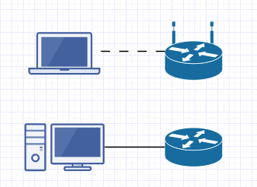
Network Diagramming Basics
Wireless
Wired
Use dotted lines to indicate a wireless connection.
Use solid lines to indicate a wired connection.
Notes:
Review goals; address any questions.

Slide 50
Activity: My Home Network (10 Minutes)
Instructions:
Take a few moments to diagram out your home network. Specifically, diagram:
All of the personal computing devices you have at home (laptop, desktop, Smart TVs, Smart Speakers).
Diagram out how these devices are connected to central device(s) prior to reaching the Internet.
Label the various elements based on the function they play.
Share your diagram when complete.
Notes:
If you are using an all-in-one wireless modem, break out the sub-components into Routers, Switches, and Wireless Access Points.

Slide 51
Activity: Client Networks (20 Minutes)
Take a few moments to diagram each of the below networks:
Campus LAN:
In this configuration, a set of twelve workstations are connected in a local-area-network. They are not connected to the internet.
Office Network:
In this configuration, a mid-sized business is looking to diagram its complete network.
They have three rooms.
Room #1 serves as a lobby for guests and has Wi-Fi access. This access is connected the larger wired network. The wired network connects each of the other rooms.
Room #2 consists of three workstations tied together in a Local Area Network.
Room #3 (the closet) consists of a Database Server, Mail Server, two Web Servers, the Router, and the Firewall. The two Web servers are connected to a Load Balancer as an intermediate step to the Router.
As you complete each of these exercises research answers to the following questions:
When is an additional router justified? Why not just use switches alone?
What exactly is load balancing? Why is it necessary?
How exactly do Firewalls work? How does this relate to the work we did in Packet Analysis?
What might be the security implications of each of these designs?

Slide 52
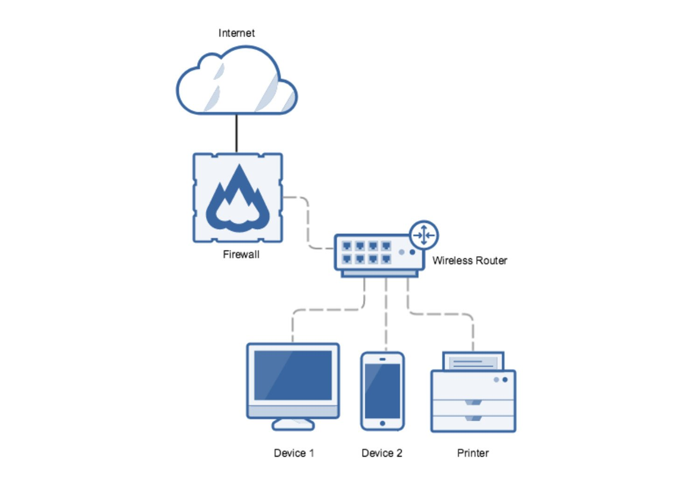
My Home Network
Your design may have looked something like the above.
Notes:
Review goals; address any questions.

Slide 53
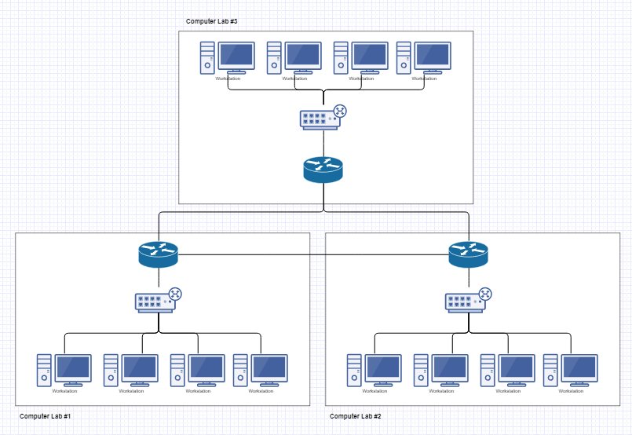
Client Networks (Campus)
Your design may have looked something like the above.
Notes:
Review goals; address any questions.

Slide 54
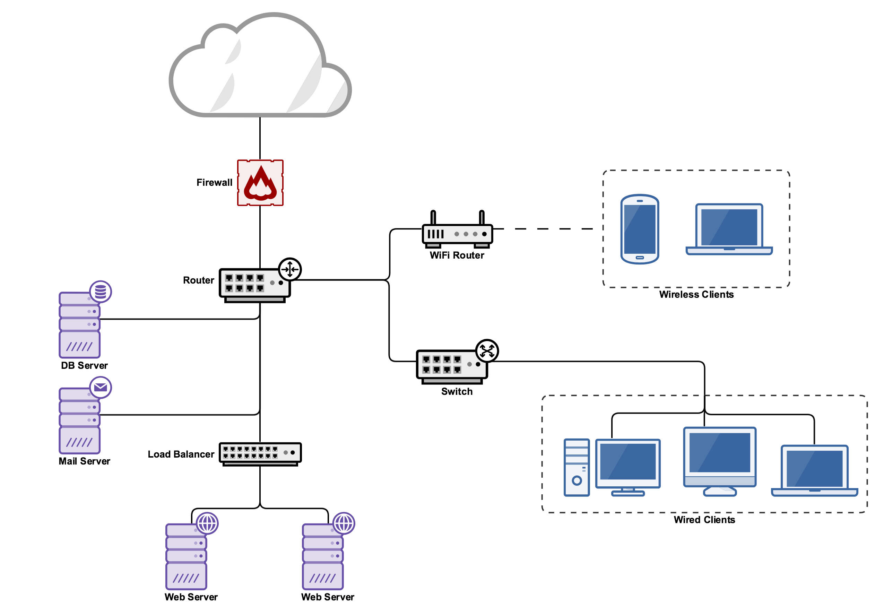
Client Networks (Office Network)
Your design may have looked something like the above.
Notes:
Review goals; address any questions.

Slide 55
Reflection Questions
Routers?
Routers?
What may be the advantages / disadvantages of more routers?
Notes:
Review goals; address any questions.

Slide 56
Reflection Questions
How do Firewalls work? What is their relationship to Packet Analysis?
Notes:
Review goals; address any questions.

Slide 57
Reflection Questions
How does load balancing work? What is it for?
Notes:
Review goals; address any questions.

Slide 58
Reflection Questions
What may be the security implications of the above designs?
Notes:
Review goals; address any questions.

Slide 59
Common Network Topologies

Slide 60
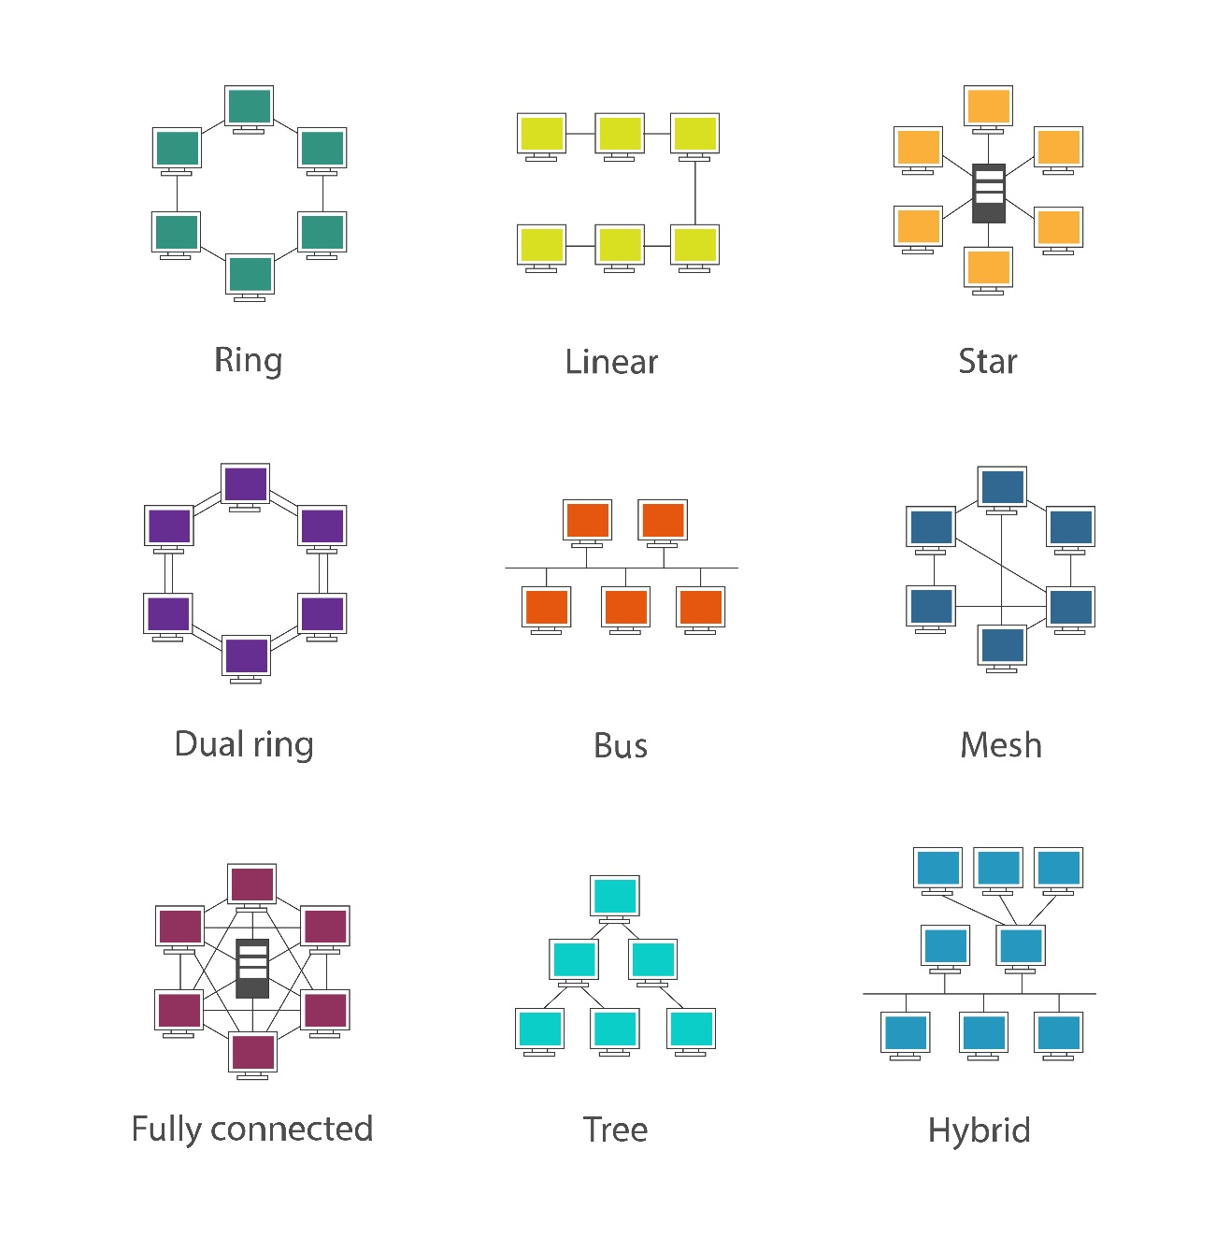
Network Topologies
While the simple diagramming rules are helpful for small designs – every network engineer is expected to be familiar with basic network topologies.
Each offers its own set of advantages and disadvantages associated with cost, setup, and maintenance.
Notes:
Review goals; address any questions.

Slide 61
Activity: Network Topologies Research (10 Minutes)
With your group, spend a few minutes researching and filling in a table that looks like the below.
Topology | Description | Advantages | Disadvantages
Linear
Bus
Ring
Star
Mesh
Tree
Hybrid

Slide 62
Network Topologies - Dissected
Topology | Description | Advantages | Disadvantages
Linear
Bus
Ring
Star
Mesh
Tree
Hybrid
Notes:
Review goals; address any questions.

Slide 63
Beyond Wires: Packets and Routers

Slide 64
Key Question
Thus far, we’ve talked a lot about networks in the abstract.
But an important question remains: How does data actually navigate these networks as in the case of the internet?

Slide 65

Sending Data From Here to There
How is it that a YouTube video about cats can make its way across space and time to arrive at my machine?
Notes:
Review goals; address any questions.

Slide 66
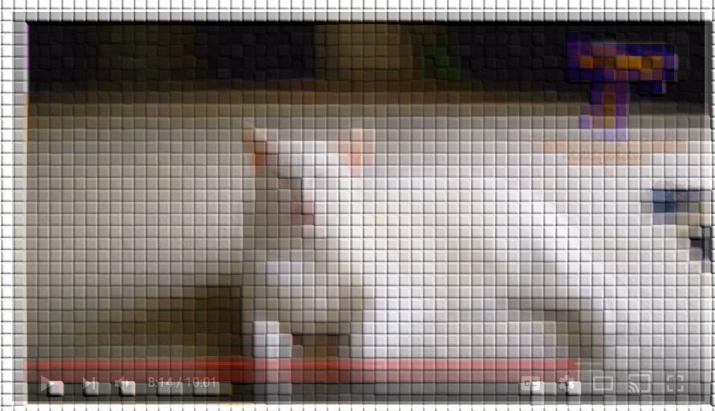
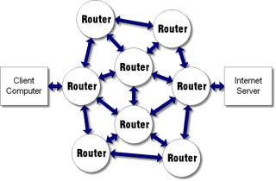
Sending Data From Here to There
Routing These Packets are relayed across networks of routers that feed-forward information to a next closest location until they are re-assembled at the endpoint.
Packets Each Request or Response is Broken into Tiny Packages of Data
Two Words:
Packets and Routing
Notes:
Review goals; address any questions.

Slide 67
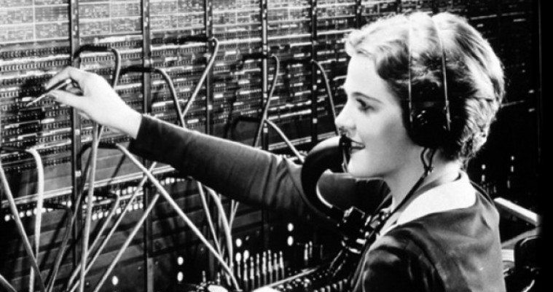
Phone Operators: The Routers of Old
Switchboard Operators played the original function that routers play today. These individuals would insert wires that directly connected phone lines across long distances in accordance with pre-defined maps.
Notes:
Review goals; address any questions.

Slide 68
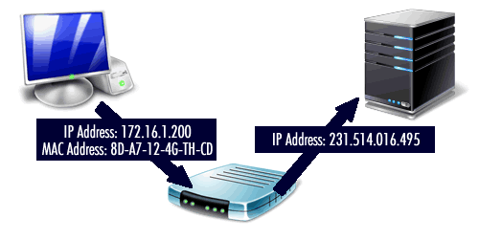
IP Addresses and MAC Addresses: Our Digital Phone Numbers
Every device is pre-assigned a MAC Address and upon connecting a router is simultaneously assigned an IP Address. These provide the information other Routers need to relay their data through the interconnected network. Routers dynamically assign IP addresses to ensure no duplicates (Dynamic Host Configuration Protocol: DHCP)
Notes:
Review goals; address any questions.

Slide 69
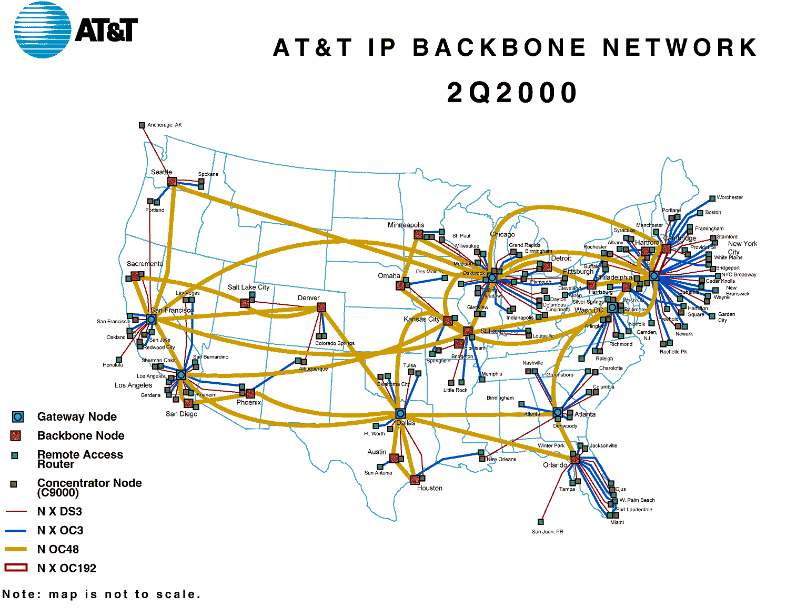
Routers and ISPs: The Operators of Today
As requests and responses are made between computer networks, routers relay each of the smaller packets across the Internet Backbone – strategically located networks and routers owned by private companies.
Upon successful receipt of the relevant packets a success response is sent back to the original host.
These concepts are powerful ideas and a huge basis for how the internet works.
Notes:
Review goals; address any questions.

Slide 70
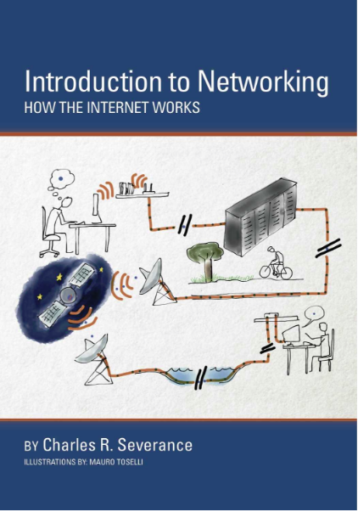
Recommended Reference
We’ll go into a bit more depth about a few of these topics over the next few classes, but much of the implementation details are out-of-scope for this class.
If you are interested, we’d highly recommend this text (available on Amazon Kindle).
Notes:
Review goals; address any questions.

Slide 71
Activity: Routing Table (5 Minutes)
Use this website (https://www.monitis.com/traceroute/) to determine the Trace Routes associated with 5 different websites.
Try to find websites that have the shortest Trace times and the longest Trace times possible.
Then answer the questions:
Why do some websites have Trace Routes that are longer than others?
Why do Trace Routes to Google.com end up in Kansas?

Slide 72
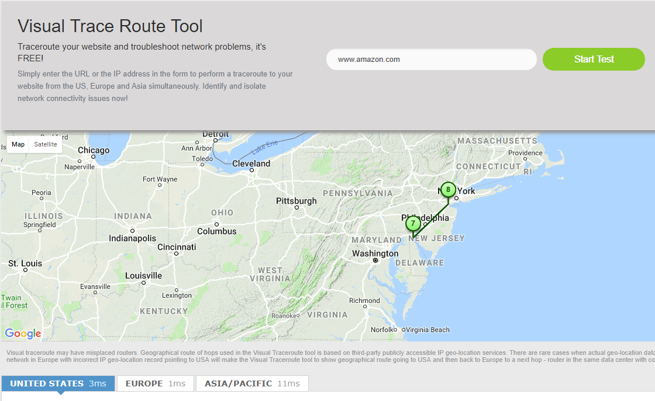
Short Traceroute (http://www.Amazon.com)
Getting From Here to There?
Notes:
Review goals; address any questions.

Slide 73
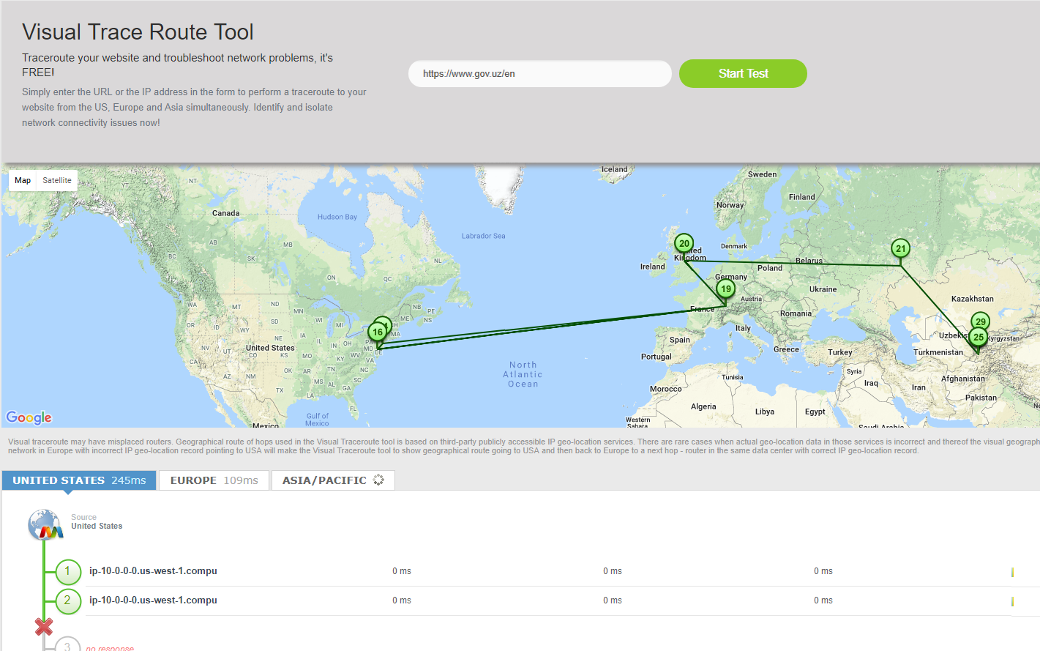
Long Traceroute (https://www.gov.uz/en)
Notes:
Review goals; address any questions.

Slide 74
Prep for Next Class!

Slide 75
Next Class (Packet Tracer)
Next class, we’ll dive deep into Network simulations – working with Packet Tracer to work with networks at the CLI level.
Notes:
Review goals; address any questions.

Slide 76
Activity: Packet Tracer Download / Setup (15 Minutes)
Instructions:
Windows Users (Easy)
Create an account on the Cisco Net Academy Website (https://www.netacad.com/).
Then scroll to the bottom under the section titled Resources and click on Packet Tracer. Download the Windows Desktop Version of Packet Tracer (64 Bit).
Install the application.
Open it once installed to confirm. Experiment with the layout by dragging a router or switch onto the design window.
Mac Users (Ugh):
There is no native version of Packet Tracer available for Macs.
We’ve instead arranged for you to use a Windows Virtual Machine to play with instead.
First create an account on the Cisco Net Academy Website.
Then load this first Virtual Machine (Virtual Box) into your machine. Attempt to drag a router or switch onto the design window. (If you experience major lag, call on your instructor for an alternative VM).

